Slide 1

Chapter 2
Instructions: Language of the Computer
Notes:
The University of Adelaide, School of Computer Science
Chapter 2 — Instructions: Language of the Computer

Slide 2

Branch Addressing
Branch instructions specify
  Opcode, two registers, target address
Most branch targets are near branch
  Forward or backward
op
rs
rt
constant or address
6 bits
5 bits
5 bits
16 bits
PC-relative addressing
  Target address = PC + offset × 4
  PC already incremented by 4 by this time
Chapter 2 — Instructions: Language of the Computer — <number>
Notes:
The University of Adelaide, School of Computer Science
Chapter 2 — Instructions: Language of the Computer

Slide 3

Jump Addressing
Jump (j and jal) targets could be anywhere in text segment
  Encode full address in instruction
op
address
6 bits
26 bits
(Pseudo)Direct jump addressing
  Target address = PC_{31…28} : (address × 4)
Chapter 2 — Instructions: Language of the Computer — <number>
Notes:
The University of Adelaide, School of Computer Science
Chapter 2 — Instructions: Language of the Computer

Slide 4
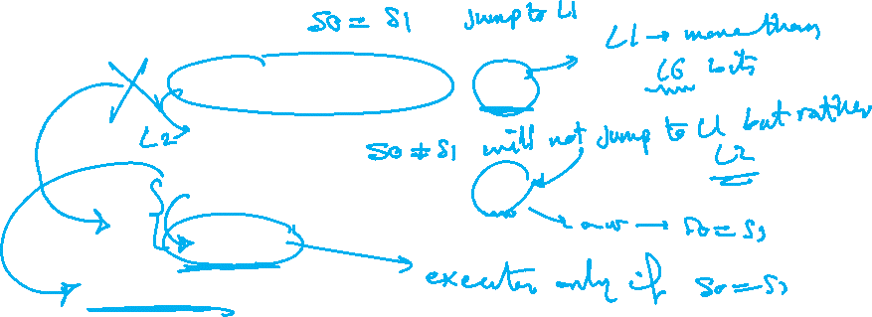
Branching Far Away
If branch target is too far to encode with 16-bit offset, assembler rewrites the code
Example
  beq $s0,$s1, L1
  ↓
  bne $s0,$s1, L2
  j L1
  L2: …
Chapter 2 — Instructions: Language of the Computer — <number>
Notes:
The University of Adelaide, School of Computer Science
Chapter 2 — Instructions: Language of the Computer

